Slide 1

Group 14 Vikings vs Spartans
Level 4/5 Group 14: Ethan Ward, Petrut Vasile, Toby White

Slide 2
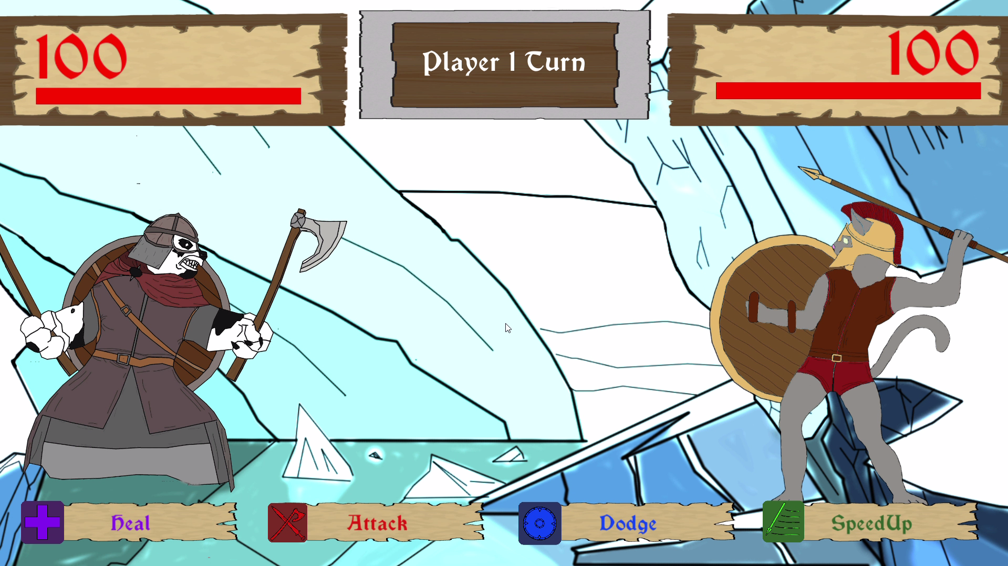
What the game looks like

Slide 3
Features and how players felt about them
Notes:
Get videos for these
Selecting an action
Pendulum
Combo attack
Thinking about removing the buttons in the main level as it is just another step for the player
Attack
Dodge
Speed up
Heal
Pendulum

Slide 4
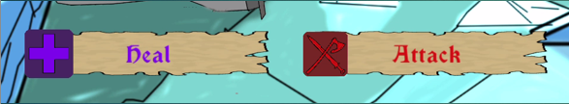
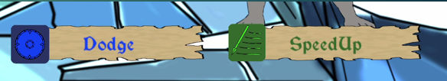
Abilities
E

Slide 5
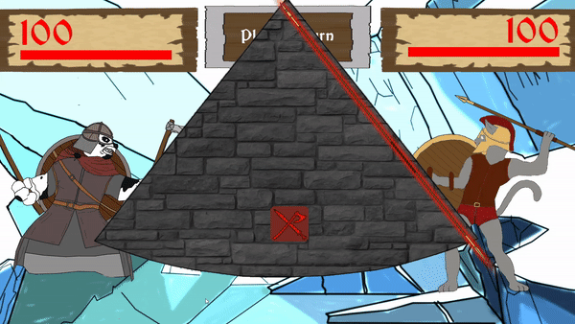
Pendulum
P

Slide 6
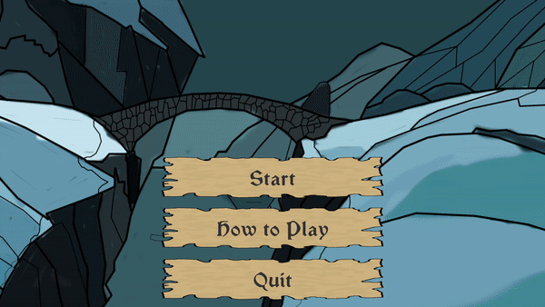
UI
T

Slide 7
How the game has been iterated to meet user feedback

Slide 8
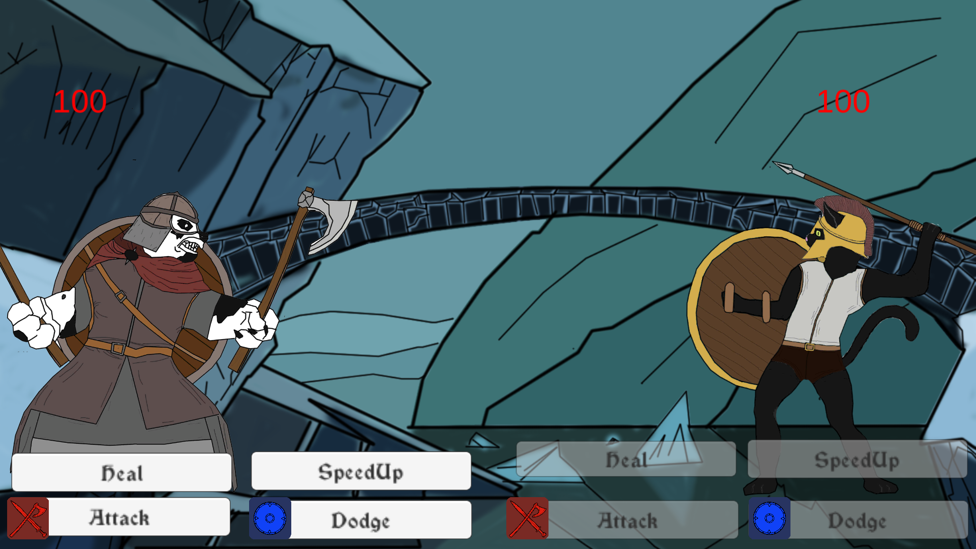
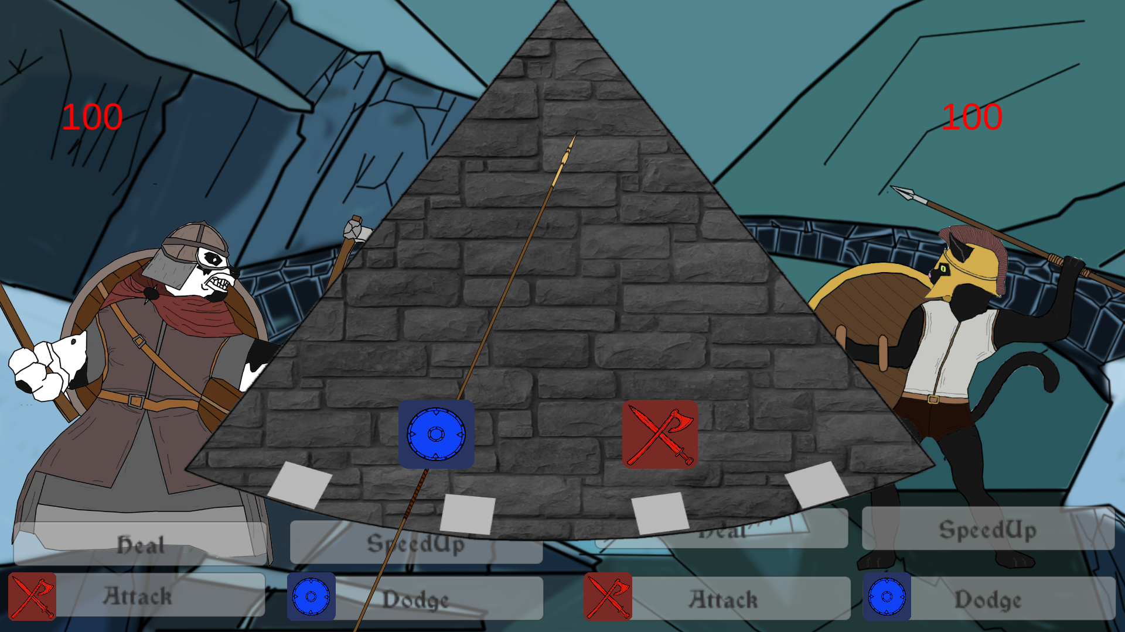
Alpha
E
Notes:
Add in screen shot of buttons/symbols
And the single pendulum
Single set of buttons
More ways to play
More intuitive

Slide 9
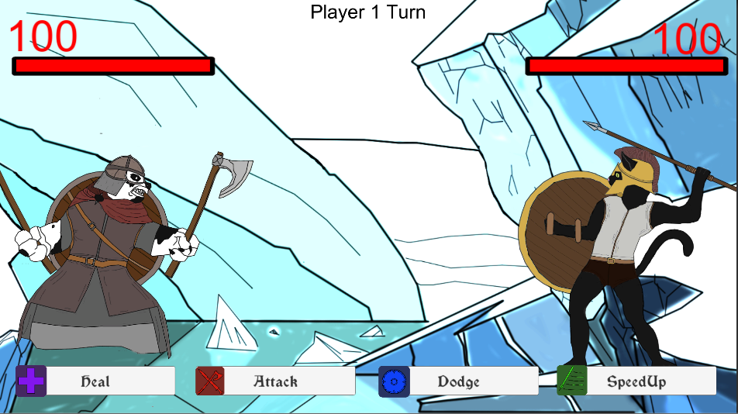
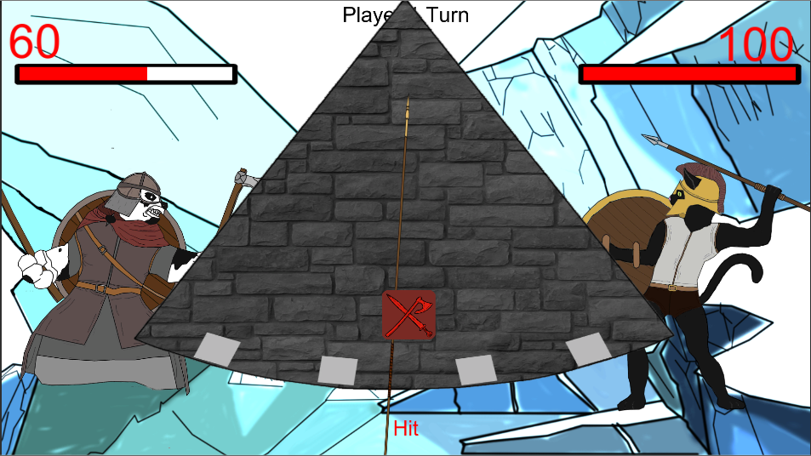
Beta
P

Slide 10
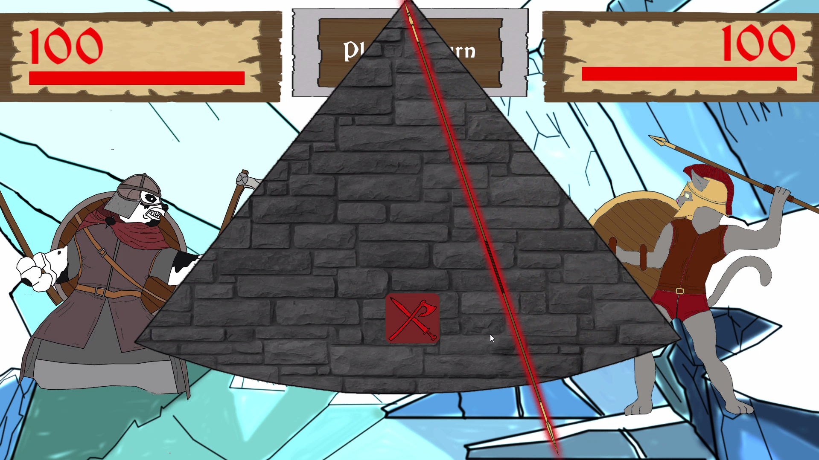
Gold
T

Slide 11
Lessons we have learned in the process

Slide 12
Management Lessons
E
Communication
Levels and speed people can work at
Dealing with issues effectively as they arise

Slide 13
Programming Lessons
P
Understand and more efficient with the software used throughout the project.
Efficient debugging
Notes:
Removed the bridge as it was interrupting the screen
Monochromatic colour palette for background
High value, low saturation colours in comparison to the characters

Slide 14
Design Lessons
T
Apply the information obtained about the demographic to the base game ideas
Properly apply design theories and principles

Slide 15
Any Questions?

